Slide 1
Announcements
The makeup date for Midterm 1 is tomorrow (October 9) from 10am-11:30am in Hayden Hall room 358
You are allowed to bring a cheat sheet
1 page printer paper with handwritten notes (writing on both sides is OK)
Upcoming:
HW4 – Sudoku Solver and Games – is due tonight
Extra Credit assignment 1 has been released, it is due on Thursday
There are several additional extra credit assignments, which will be due on Thursdays
HW5 – Markov Decision Processes is due in 2 weeks on Tuesday Oct 22
You can check out an R2D2 today before lecture or after lecture
My office hours are today from 3-4pm in 3401 Walnut room 463C
Notes:
[cut demo of moving around in grid world program]

Slide 2

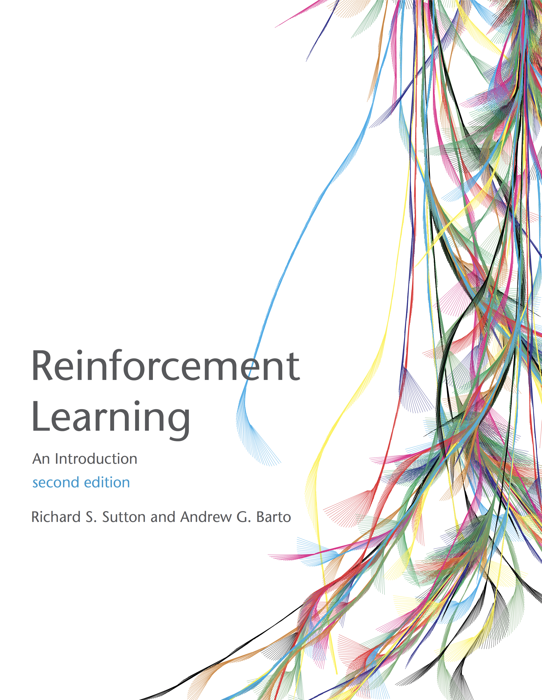
MDP Wrap-up + Reinforcement Learning
Sutton and Barto, Chapter 6.1, 6.2, 6.5 AIMA Chapter 21
Slides courtesy of Dan Klein and Pieter Abbeel University of California, Berkeley

Slide 3
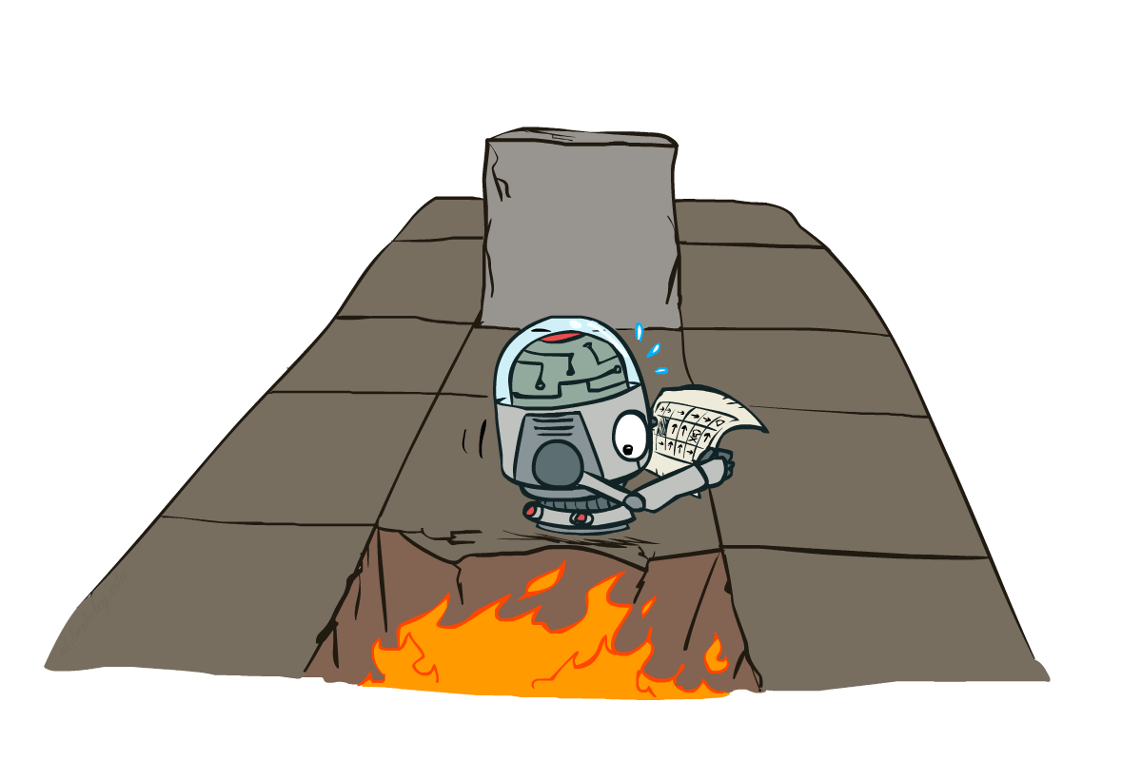
Markov Decision Processes -wrapup
Slides courtesy of Dan Klein and Pieter Abbeel --- University of California, Berkeley
[These slides were created by Dan Klein and Pieter Abbeel for CS188 Intro to AI at UC Berkeley. All CS188 materials are available at http://ai.berkeley.edu.]
Notes:
Please retain proper attribution, including the reference to ai.berkeley.edu. Thanks!

Slide 4

Review: The Bellman Equations
How to be optimal:
Step 1: Take correct first action
Step 2: Keep being optimal

Slide 5


Review: The Bellman Equations
Definition of “optimal utility” via expectimax recurrence gives a simple one-step lookahead relationship amongst optimal utility values
These are the Bellman equations, and they characterize optimal values in a way we’ll use over and over
s
a
s, a
s,a,s’
s’
Notes:
Let’s start by equations that characterize these quantities through mutual recursions. [step through this by writing on slide, one step at a time]
Recursive characterization of V* in terms of V*; not necessarily helpful; but it is a characterization.
Note: this is a set of equations that needs to be satisfied; but it could have multiple solutions (it does not, but at this stage of our knowledge it could).

Slide 6
Review: Value Iteration
Start with V₀(s) = 0: no time steps left means an expected reward sum of zero
Given vector of V_{k}(s) values, do one ply of expectimax from each state:
Repeat until convergence
Complexity of each iteration: O(S²A)
Theorem: will converge to unique optimal values
Basic idea: approximations get refined towards optimal values
Policy may converge long before values do
V_{k+1}(s)
a
s, a
s,a,s’
V_{k}(s’)
Notes:
We are going to store all of the V values in a vector. For V_0, everything is just 0.
The recursion is into an Expectimax tree that we have already compted. The recursion won’t actually happen because we’ve already got it.
What will this do, we can go from 0, to 1 to 2, to K. Each time we will go deeper into the tree. When should we stop? When the values start to converge.
Complexity = we do this update for each state, then we do a little expectimax. We do a for loop over A to take take a max over each action, then we do another for loop that goes over each state again.

Slide 7

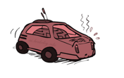
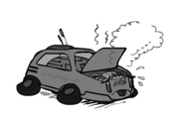
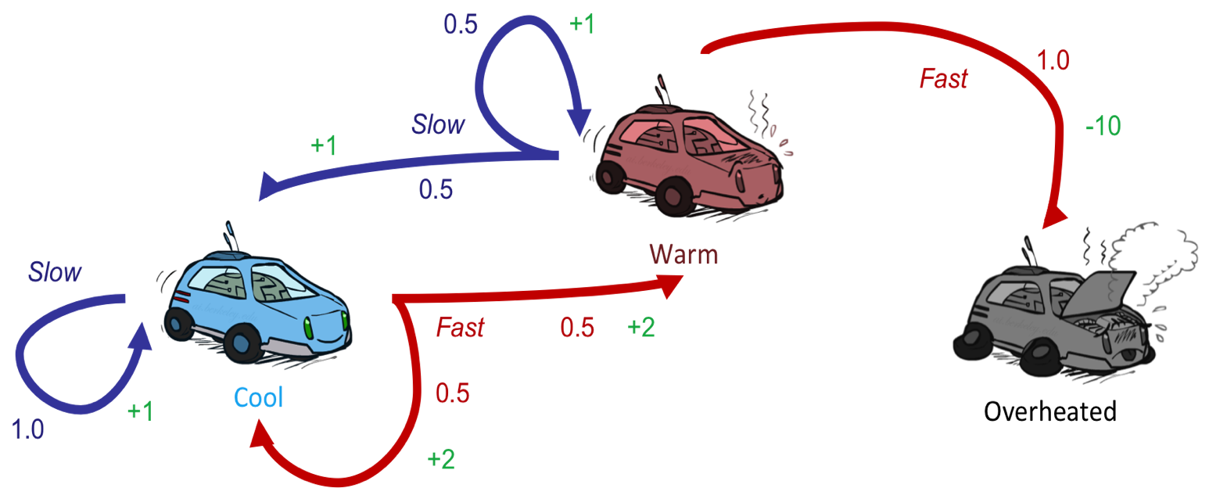
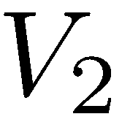
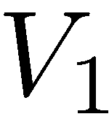
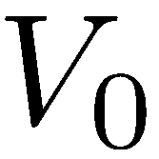
Review: Value Iteration
3.5 2.5 0
2 1 0
(Here we assume no discount)
0 0 0
Notes:
V0 = 0 , 0 , 0
For V1.
On we’re going to do a little expectimax search for each value. As an equation that’s the V_k+1 ….
Let’s start with the cool state. But let’s think about it in terms of actions. What should I do. If I go slow, then I get +1, if I go fast then I get +2.
Now with the fast state, if I go slow then I get +1, if I go fast then I get -10. so max value is 1.
For V2,
Cool:
SLOW If I go slow then what do I get? I get 1, and if there’s no discount, then I’m going to land back at cool, so 2 is the Vk-1. Total is 2.
FAST If I go fast, then I’ve got a 2 instantaneously then I have a 50%/50% chance of plugging in 2 because I got sent back to cool, and plugging in 1 if I go to 1. Total = 3.5
So for cool, the max works out to 3.5
If I work that out for the warm state, then that comes out to 2.5.
As I go further up, then the numbers go up. That makes sense because I’m accumulating rewards at each step.
From this we can work out an optimal policy (when you’re cool go fast when you’re warm go slow).

Slide 8
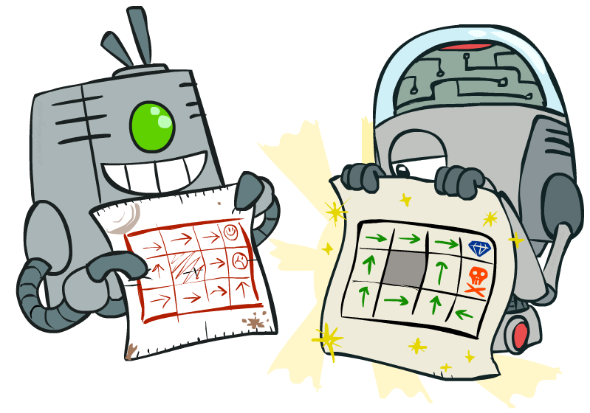
Policy Methods
Notes:
Good policies v. bad policies. Methods to work over policies to make them better, rather than over values.

Slide 9
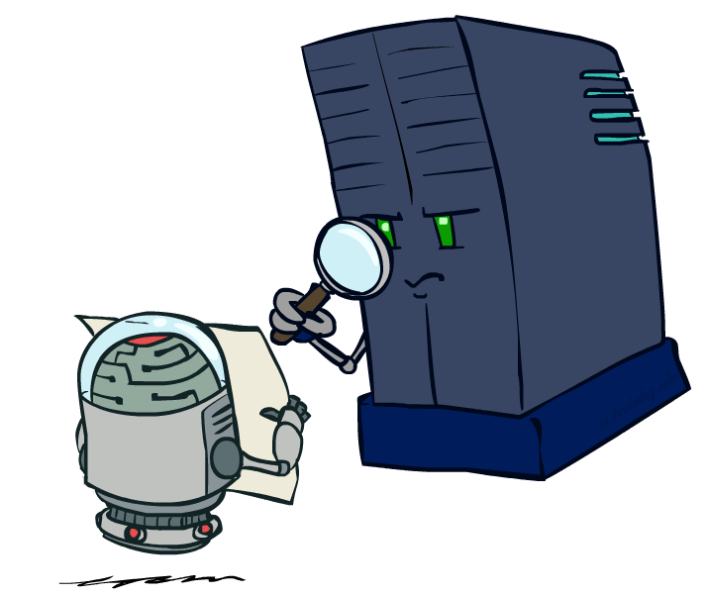
Policy Evaluation
Notes:
Figure out for a policy, what the values are.

Slide 10
Fixed Policies
Do the optimal action
Do what π says to do
s
s
a
π(s)
s, a
s, π(s)
s,a,s’
s, π(s),s’
s’
s’
Expectimax trees max over all actions to compute the optimal values
If we fixed some policy π(s), then the tree would be simpler – only one action per state
… though the tree’s value would depend on which policy we fixed
Notes:
So far we’ve only been talking about executing under optimal actions. That gave us optimal values and therefore optimal behaviors.
Here we’re going to talk about what to do under a fixed policy, pi.
If I have a fixed policy, then I don’t have a lot choices. I don’t have to max over the set of possible actions anymore. Essentially the tree is pruned.

Slide 11
Utilities for a Fixed Policy
Another basic operation: compute the utility of a state s under a fixed (generally non-optimal) policy
Define the utility of a state s, under a fixed policy π:
V^{π}(s) = expected total discounted rewards starting in s and following π
Recursive relation (one-step look-ahead / Bellman equation):
s
π(s)
s, π(s)
s, π(s),s’
s’
Notes:
Under optimal policies one thing we needed to do was to calculate the utility of a state.
We’ll need to do that again. Now it’s actually easier.
We need to write an equation. We used to write a maximum. We don’t need to do that anymore. But we still need to consider all possible outcomes.
The function pi takes in a state and returns an action. It could be implemented in code as a hash table. Same kind of bellman equation, but the max over a is gone. Recursive relation that is a one step look ahead.

Slide 12
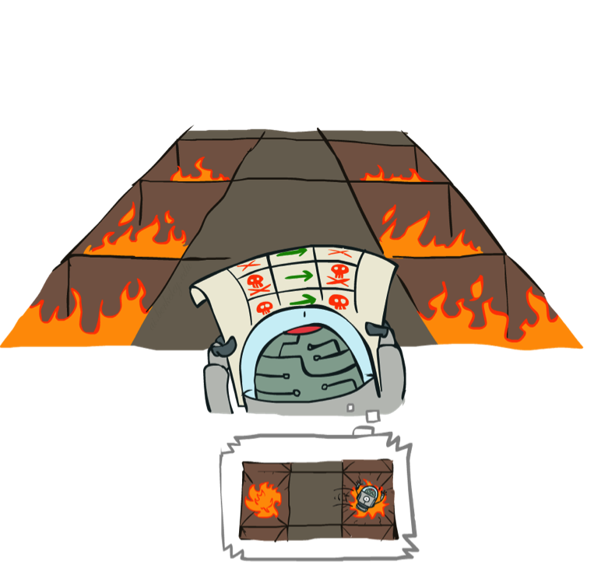
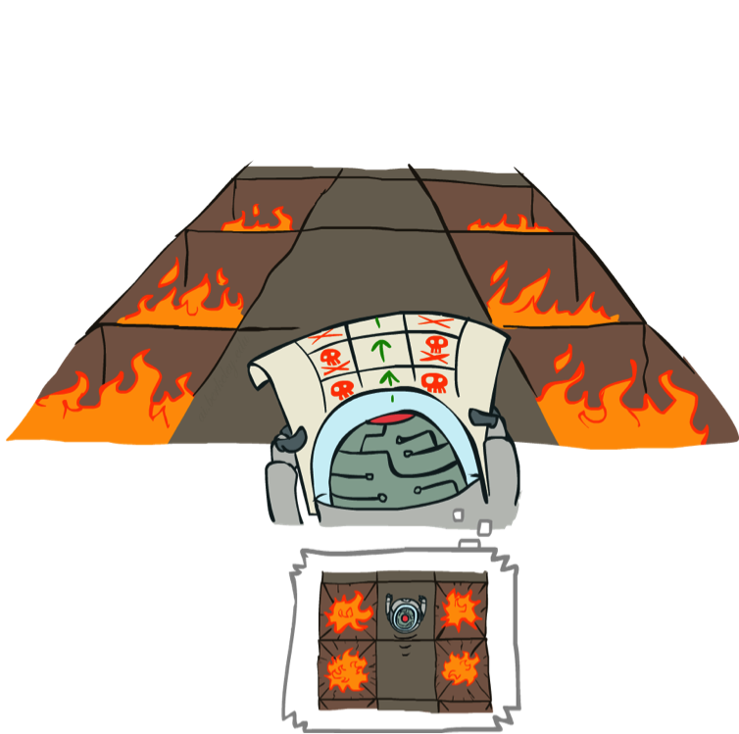
Example: Policy Evaluation
Always Go Right
Always Go Forward
Notes:
Here’s an example of policy evaluation. How about this one? It’s bad. The agent can simulate it in its head and decide that it is bad.
This one looks better. The robot can think about it and decide that it’s better than the previous one.
If it’s got a choice then it will pick this policy.

Slide 13
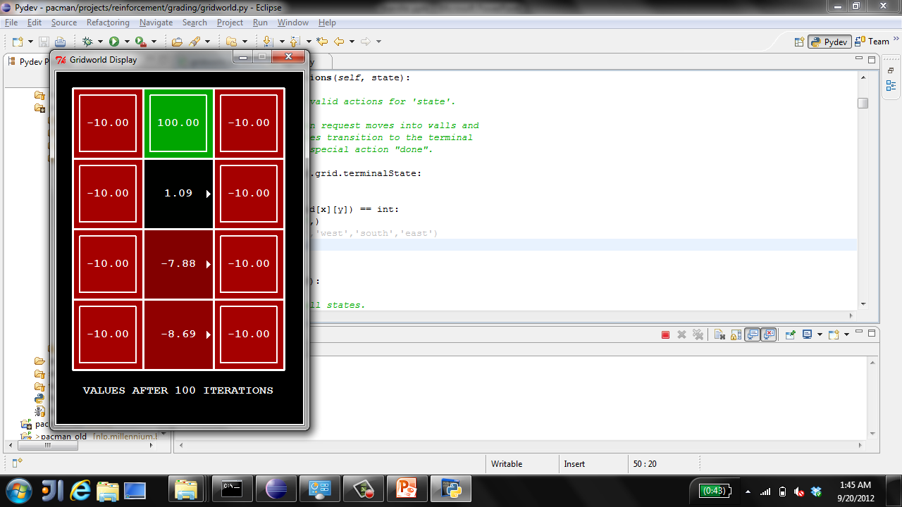
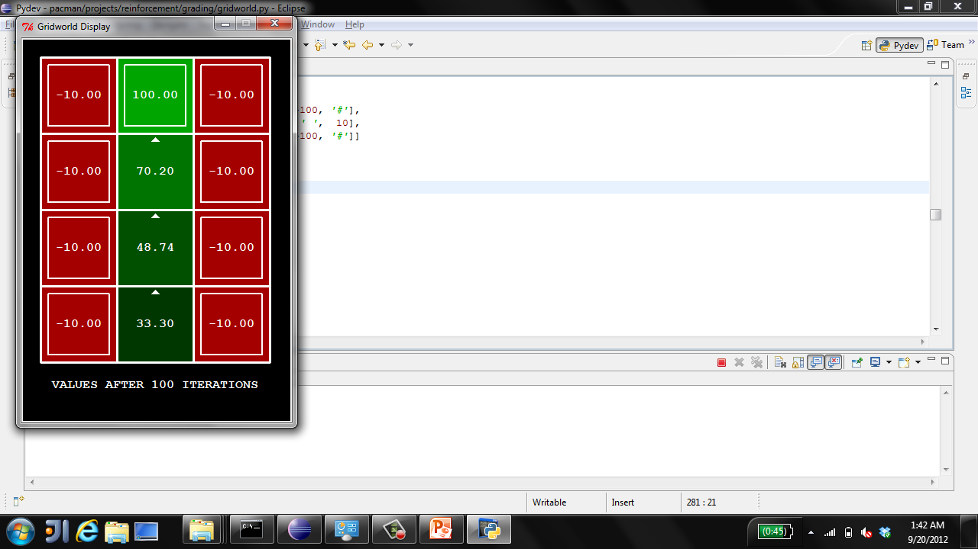
Example: Policy Evaluation
Always Go Right
Always Go Forward
Notes:
Here’s how the values work out.
The always go right one doesn’t work out so well in less you’re on the exit square. But importantly, it has values. So we can evaluate how good it is.
The second has better values.
The reason we want to evaluate policies, is that we will look at algorithms that start with one policy, evaluate it, and then look at ways of improving it.

Slide 14

Policy Evaluation
s
How do we calculate the V’s for a fixed policy π?
Idea 1: Turn recursive Bellman equations into updates
(like value iteration)
Efficiency: O(S²) per iteration
Idea 2: Without the maxes, the Bellman equations are just a linear system
Solve with Matlab (or your favorite linear system solver)
π(s)
s, π(s)
s, π(s),s’
s’
Notes:
One way is to look at it just like value iteration.
At V_0, give 0.
Then recursively, compute it for iteratively higher k.
Imagine I have k+1 time steps left.
Take the action pi of S.
Average over all possible states s’
Add the instantaneous reward R
plus the discounted future reward at the landing state s until the end of time.
This is more efficient than standard value iteration.
For every iteration, we visit each state. The maximum number of possible landing states s’ is s. This assumes that every state is connected to every other state, which is usually not the case, so this is an upper bound on the complexity.
This O(S^2) no longer has the A term.
Without the maxes, you can actually just solve it as a system of linear equations.

Slide 15
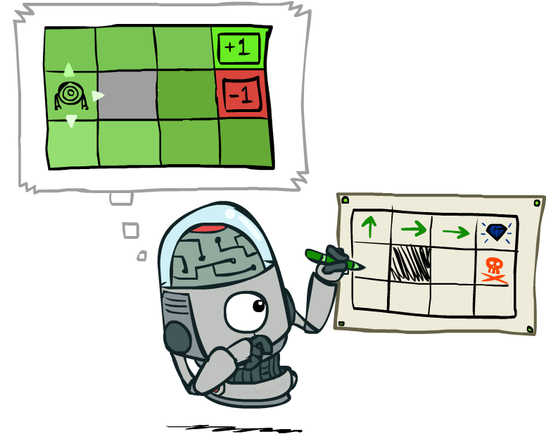
Policy Extraction
Notes:
OK, so we just looked at the situation where we are given a policy, and we need to assign values to it.
Now let’s look at the opposite. Given a set of values (which we assume to be correct), what’s the best policy?

Slide 16
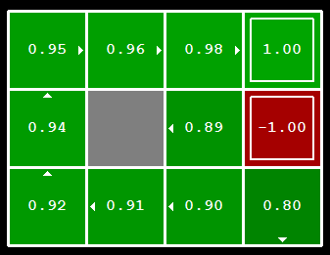
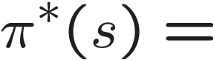
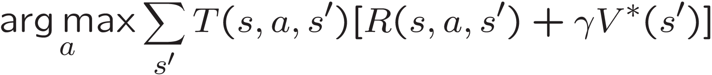
Computing Actions from Values
Let’s imagine we have the optimal values V*(s)
How should we act?
It’s not obvious!
We need to do a mini-expectimax (one step)
This is called policy extraction, since it gets the policy implied by the values
Notes:
Let’s compute the actions to take given the values.
Someone gives us the optimal values.
How should I act?
Look at the interesting square on the ledge.
.89 – that’s not bad. Should I choose to go North? South? It turns out that here we shouldn’t go north to the .98, but we shouldn’t head in that direction. We should hit the wall and wait to move up by chance.
The values let you figure out that the square to the north is better than you, but not how to get there.
So it’s not obvious how to act optimally given the values.
If you didn’t have the helpful arrows here, and you only had the optimal values, how would you figure out how to act.
The answer to that is you basically have to do expectimax.
You have to unroll this and see which was the action that gave rise to these values.
We don’t have to do it very deeply. We’ll see when we unroll it we’ll need to recurse, but we’ve already got those actions, so we only have to go one step deep.
[write equation on the board, initially omitting argmax]
…
The discounted future is given to us, since we have V*(s).
Notation over a is arg max. Instead of giving me the maximum value, it gives me the action a that achieves the maximum.
This one step look ahead according to a given set of values is called policy extraction, since it returns the policy implied by the values.

Slide 17
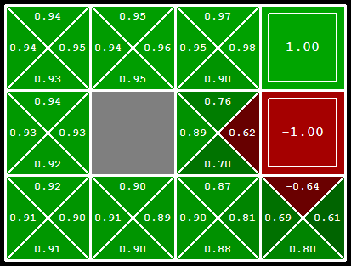
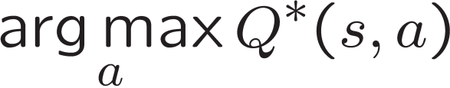
Computing Actions from Q-Values
Let’s imagine we have the optimal q-values:
How should we act?
Completely trivial to decide!
Important lesson: actions are easier to select from q-values than values!
Notes:
What about q-values? This is less intuitive to think about than the regular values.
Let’s think about the state where we’re on the ledge again. What action should we take now? It’s trivial!
Essentially, they have already unrolled the state for you.
It’s much easier to extract actions from q-values than from values. This is an important lesson, and it’s going to come up again in reinforcement learning.

Slide 18
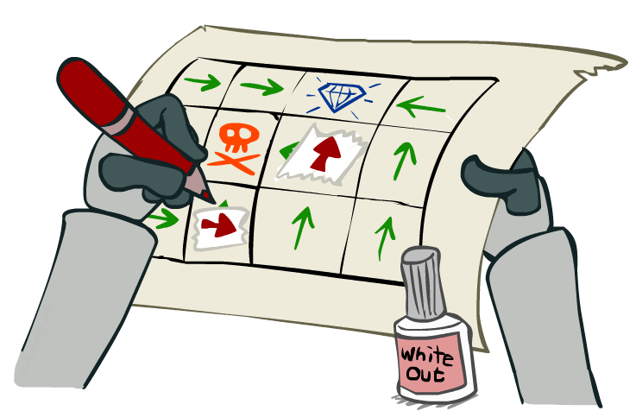
Policy Iteration
Notes:
Next we’re going to look into an important algorithm called policy iteration. It combines the idea of evaluating a policy with improving that policy based on its values.

Slide 19
Problems with Value Iteration
Value iteration repeats the Bellman updates:
Problem 1: It’s slow – O(S²A) per iteration
Problem 2: The “max” at each state rarely changes
Problem 3: The policy often converges long before the values
s
a
s, a
s,a,s’
s’
[Demo: value iteration (L9D2)]
Notes:
Demo steps through value iteration; snapshots of values shown on next slides.

Slide 20
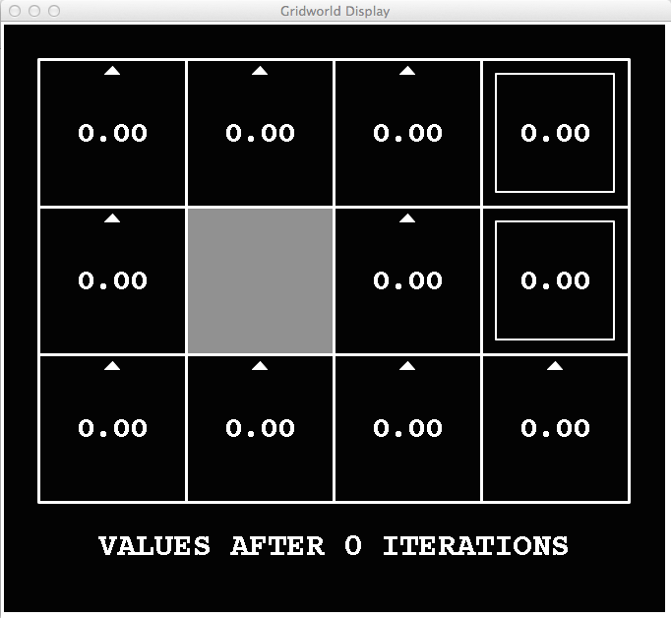
k=0
Noise = 0.2
Discount = 0.9
Living reward = 0
Notes:
At V0 we don’t have any values.
We’re going to walk through this twice. On the first time take a look at the arrows and when they change. At first they change a lot, then they slow down, then most of them don’t change at all after about V7 or V8.
Next look at the values in the bottom left. It takes a long time before the values get high enough to effect the arrows.

Slide 21
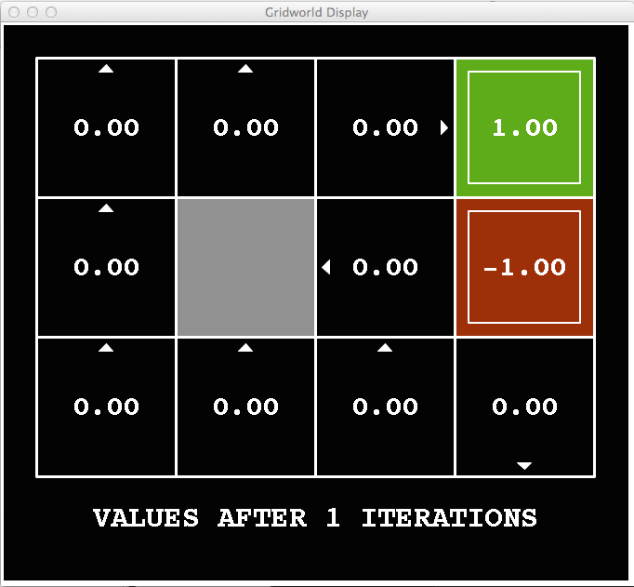
k=1
Noise = 0.2
Discount = 0.9
Living reward = 0
Notes:
We’re going to walk through this twice. On the first time take a look at the arrows and when they change. At first they change a lot, then they slow down, then most of them don’t change at all after about V7 or V8.
Next look at the values in the bottom left. It takes a long time before the values get high enough to effect the arrows.

Slide 22
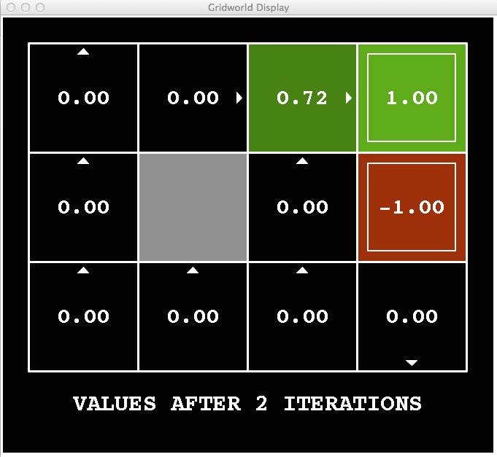
k=2
Noise = 0.2
Discount = 0.9
Living reward = 0
Notes:
We’re going to walk through this twice. On the first time take a look at the arrows and when they change. At first they change a lot, then they slow down, then most of them don’t change at all after about V7 or V8.
Next look at the values in the bottom left. It takes a long time before the values get high enough to effect the arrows.

Slide 23
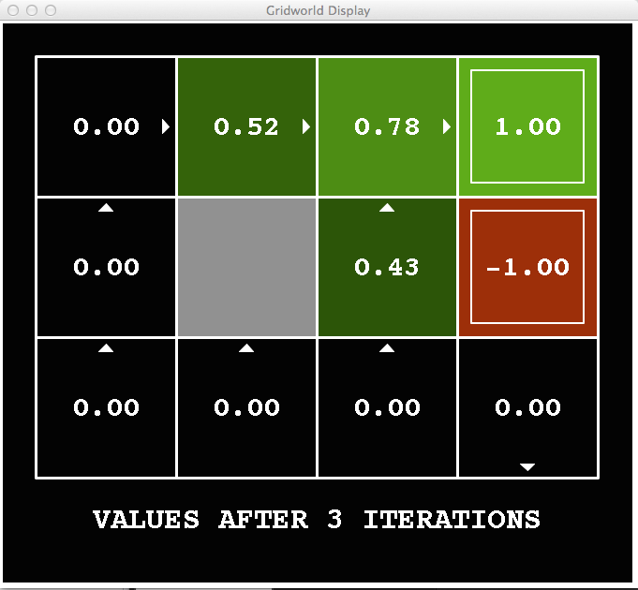
k=3
Noise = 0.2
Discount = 0.9
Living reward = 0
Notes:
We’re going to walk through this twice. On the first time take a look at the arrows and when they change. At first they change a lot, then they slow down, then most of them don’t change at all after about V7 or V8.
Next look at the values in the bottom left. It takes a long time before the values get high enough to effect the arrows.

Slide 24
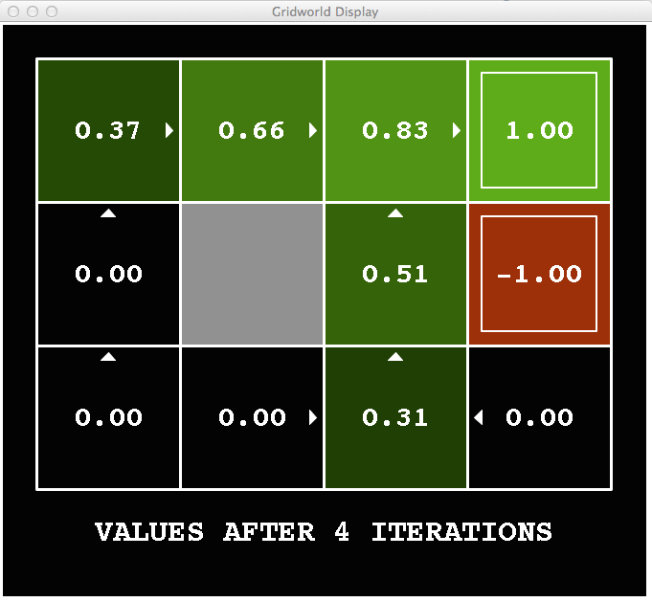
k=4
Noise = 0.2
Discount = 0.9
Living reward = 0
Notes:
We’re going to walk through this twice. On the first time take a look at the arrows and when they change. At first they change a lot, then they slow down, then most of them don’t change at all after about V7 or V8.
Next look at the values in the bottom left. It takes a long time before the values get high enough to effect the arrows.

Slide 25
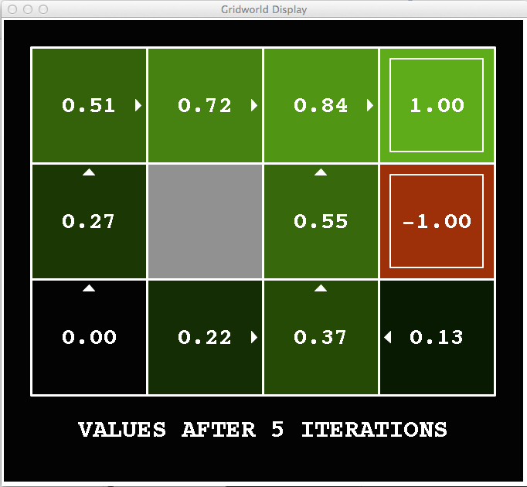
k=5
Noise = 0.2
Discount = 0.9
Living reward = 0
Notes:
We’re going to walk through this twice. On the first time take a look at the arrows and when they change. At first they change a lot, then they slow down, then most of them don’t change at all after about V7 or V8.
Next look at the values in the bottom left. It takes a long time before the values get high enough to effect the arrows.

Slide 26
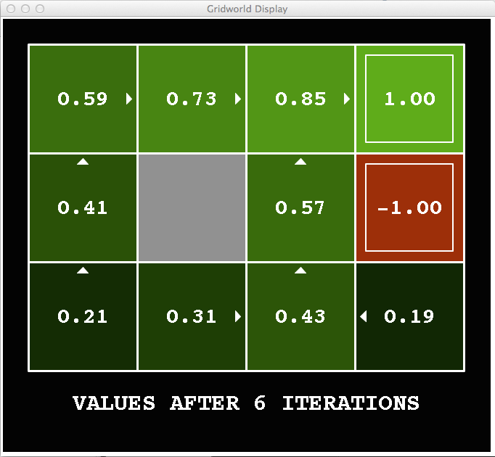
k=6
Noise = 0.2
Discount = 0.9
Living reward = 0
Notes:
We’re going to walk through this twice. On the first time take a look at the arrows and when they change. At first they change a lot, then they slow down, then most of them don’t change at all after about V7 or V8.
Next look at the values in the bottom left. It takes a long time before the values get high enough to effect the arrows.

Slide 27
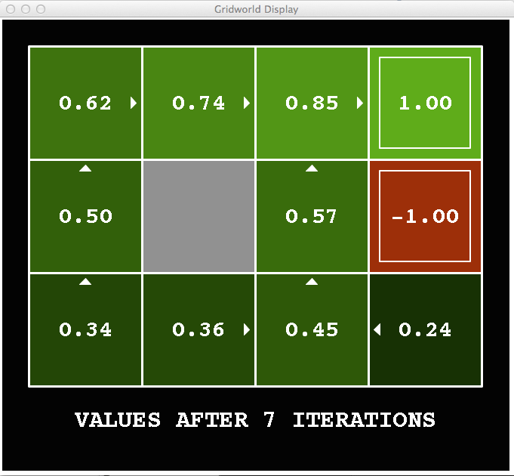
k=7
Noise = 0.2
Discount = 0.9
Living reward = 0
Notes:
We’re going to walk through this twice. On the first time take a look at the arrows and when they change. At first they change a lot, then they slow down, then most of them don’t change at all after about V7 or V8.
Next look at the values in the bottom left. It takes a long time before the values get high enough to effect the arrows.

Slide 28
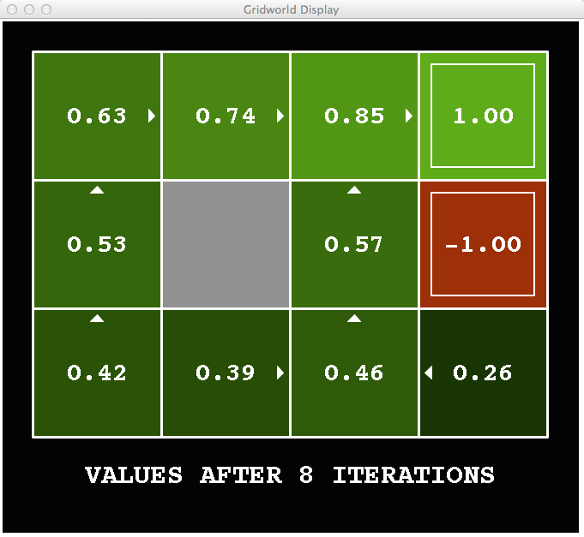
k=8
Noise = 0.2
Discount = 0.9
Living reward = 0
Notes:
We’re going to walk through this twice. On the first time take a look at the arrows and when they change. At first they change a lot, then they slow down, then most of them don’t change at all after about V7 or V8.
Next look at the values in the bottom left. It takes a long time before the values get high enough to effect the arrows.

Slide 29
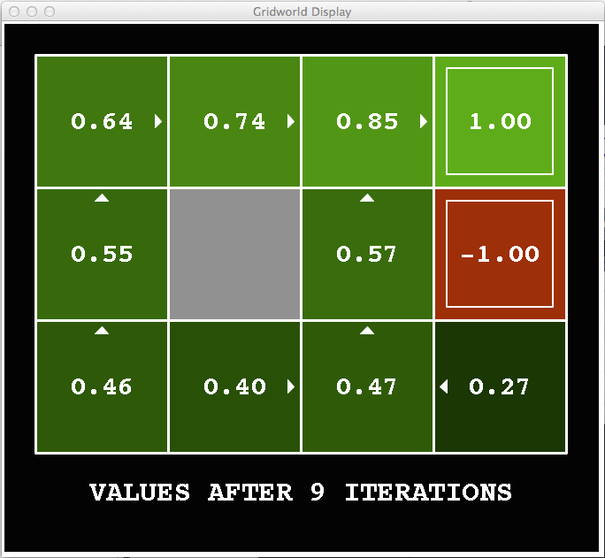
k=9
Noise = 0.2
Discount = 0.9
Living reward = 0
Notes:
We’re going to walk through this twice. On the first time take a look at the arrows and when they change. At first they change a lot, then they slow down, then most of them don’t change at all after about V7 or V8.
Next look at the values in the bottom left. It takes a long time before the values get high enough to effect the arrows.

Slide 30

k=10
Noise = 0.2
Discount = 0.9
Living reward = 0
Notes:
We’re going to walk through this twice. On the first time take a look at the arrows and when they change. At first they change a lot, then they slow down, then most of them don’t change at all after about V7 or V8.
Next look at the values in the bottom left. It takes a long time before the values get high enough to effect the arrows.

Slide 31

k=11
Noise = 0.2
Discount = 0.9
Living reward = 0
Notes:
We’re going to walk through this twice. On the first time take a look at the arrows and when they change. At first they change a lot, then they slow down, then most of them don’t change at all after about V7 or V8.
Next look at the values in the bottom left. It takes a long time before the values get high enough to effect the arrows.

Slide 32
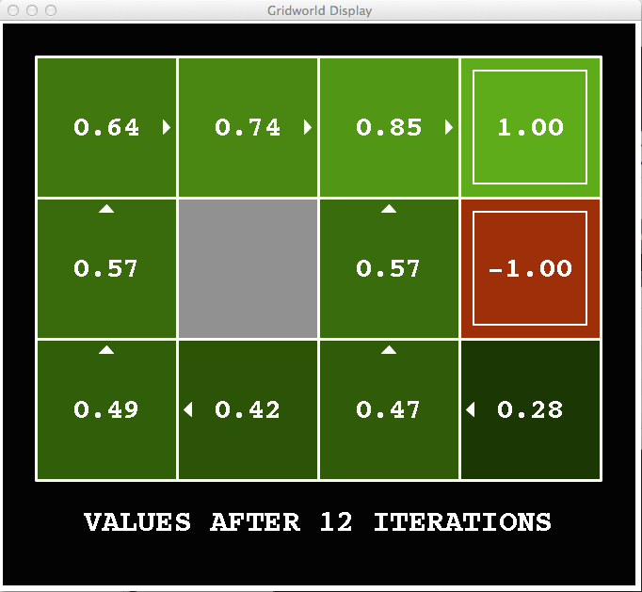
k=12
Noise = 0.2
Discount = 0.9
Living reward = 0
Notes:
We’re going to walk through this twice. On the first time take a look at the arrows and when they change. At first they change a lot, then they slow down, then most of them don’t change at all after about V7 or V8.
Next look at the values in the bottom left. It takes a long time before the values get high enough to effect the arrows.

Slide 33

k=100
Noise = 0.2
Discount = 0.9
Living reward = 0
Notes:
We’re going to walk through this twice. On the first time take a look at the arrows and when they change. At first they change a lot, then they slow down, then most of them don’t change at all after about V7 or V8.
Next look at the values in the bottom left. It takes a long time before the values get high enough to effect the arrows.

Slide 34
Problems with Value Iteration
Value iteration repeats the Bellman updates:
Problem 1: It’s slow – O(S²A) per iteration
Problem 2: The “max” at each state rarely changes
Problem 3: The policy often converges long before the values
s
a
s, a
s,a,s’
s’
Notes:
[Re-iterate the problems.]
So what can we do?

Slide 35
Policy Iteration
Alternative approach for optimal values:
Step 1: Policy evaluation: calculate utilities for some fixed policy (not optimal utilities!) until convergence
Step 2: Policy improvement: update policy using one-step look-ahead with resulting converged (but not optimal!) utilities as future values
Repeat steps until policy converges
This is policy iteration
It’s still optimal!
Can converge (much) faster under some conditions
Notes:
We’re going to look at an alternate called policy evaluation.

Slide 36
Policy Iteration
Step 1 (Policy Evaluation): For fixed current policy π, find values with policy evaluation:
Iterate until values converge:
Step 2 (Policy Improvement): For fixed values, get a better policy using policy extraction
One-step look-ahead:
Notes:
If we wrote this out in equation, it would look like this.
Step 1 is policy evaluation. I do this simplified update where I don’t max over the actions. I only do the averaging on the chance nodes. It’s fast, since I don’t consider all of the actions. I do this until it convergences.
Step 2 is policy improvement. I do one layer of expectimax. Our truncation function is the old policy. That’s a bit weird right? I’m pushing the old stuff one step into the future and thereby make progress.
If you think about this, the improvement step is just like value iteration. So it’s not going to be very fast. All of the speed gains come from the evaluation step. So we run that many times before allowing an improvement step.

Slide 37
Comparison
Both value iteration and policy iteration compute the same thing (all optimal values)
In value iteration:
Every iteration updates both the values and (implicitly) the policy
We don’t track the policy, but taking the max over actions implicitly recomputes it
In policy iteration:
We do several passes that update utilities with fixed policy (each pass is fast because we consider only one action, not all of them)
After the policy is evaluated, a new policy is chosen (slow like a value iteration pass)
The new policy will be better (or we’re done)
Both are dynamic programs for solving MDPs
Notes:
OK, let’s compare them. They do the same thing. Both take in an MDP. They both output an optimal quality. On the surface they both output optimal values. Policy iteration explicitly outputs the optimal policy, value iteration does it implicitly.
Both are the same class of things. They are dynamic programs for solving MDPs.

Slide 38
Summary: MDP Algorithms
So you want to….
Compute optimal values: use value iteration or policy iteration
Compute values for a particular policy: use policy evaluation
Turn your values into a policy: use policy extraction (one-step lookahead)
These all look the same!
They basically are – they are all variations of Bellman updates
They all use one-step lookahead expectimax fragments
They differ only in whether we plug in a fixed policy or max over actions
Notes:
These are all Bellman equations turned into a one step look ahead.

Slide 39
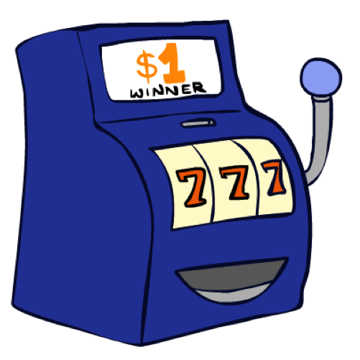
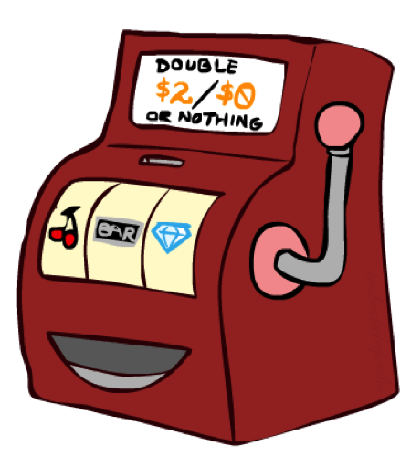

Double Bandits
Notes:
one-armed bandit A slot machine, as in It's amazing how many people think they can make money playing a one-armed bandit. This term refers to both appearance and function: the operating lever looks like an arm, and the machine in effect robs players, since it “wins” and keeps the player's money in an overwhelming majority of instances

Slide 40
Double-Bandit MDP
Actions: Blue, Red
States: Win, Lose
No discount
100 time steps
Both states have the same value
0.25 $0
0.75
$2
W
L
0.25
$0
$1
1.0
$1
1.0
0.75 $2

Slide 41
Offline Planning
Solving MDPs is offline planning
You determine all quantities through computation
You need to know the details of the MDP
You do not actually play the game!
No discount
100 time steps
Both states have the same value
0.25 $0
Value
0.75
$2
W
0.25
$0
Play Red
150
L
$1
1.0
$1
1.0
0.75 $2
Play Blue
100

Slide 42
Let’s Play!
$2
$2
$0
$2
$2
$2
$2
$0
$0
$0
Notes:
What actually happens? We actually won real fake money, instead of just thinking about it. We won $12 for 10 plays. Instead of our estimate of $15.

Slide 43
Online Planning
Rules changed! Red’s win chance is different.
?? $0
??
$2
W
L
??
$0
$1
1.0
$1
1.0
?? $2
Notes:
Now we aren’t given the probabilities. Red has a payoff but you don’t know what it is.
We don’t know the MDP! We can’t calculate its values. So what should we do? Give up and go home? No, let’s try it out by playing.

Slide 44
Let’s Play!
$0
$0
$0
$2
$0
$2
$0
$0
$0
$0
Notes:
Who wants to play red? Do we know that’s the optimal policy? What should we play? Red! Red! Red! When should we stop?
This is a different setting. Red is an MDP. It has a payoff. You don’t know what it is.
What you have to do is an optimal amount of discovery mixed in with not losing your money.

Slide 45
What Just Happened?
That wasn’t planning, it was learning!
Specifically, reinforcement learning
There was an MDP, but you couldn’t solve it with just computation
You needed to actually act to figure it out
Important ideas in reinforcement learning that came up
Exploration: you have to try unknown actions to get information
Exploitation: eventually, you have to use what you know
Regret: even if you learn intelligently, you make mistakes
Sampling: because of chance, you have to try things repeatedly
Difficulty: learning can be much harder than solving a known MDP
Notes:
Difficulty: In the original case, it was instantly obvious that you should always play red. Here your lack of knowledge makes it much more difficult to figure out the optimal policy.

Slide 46
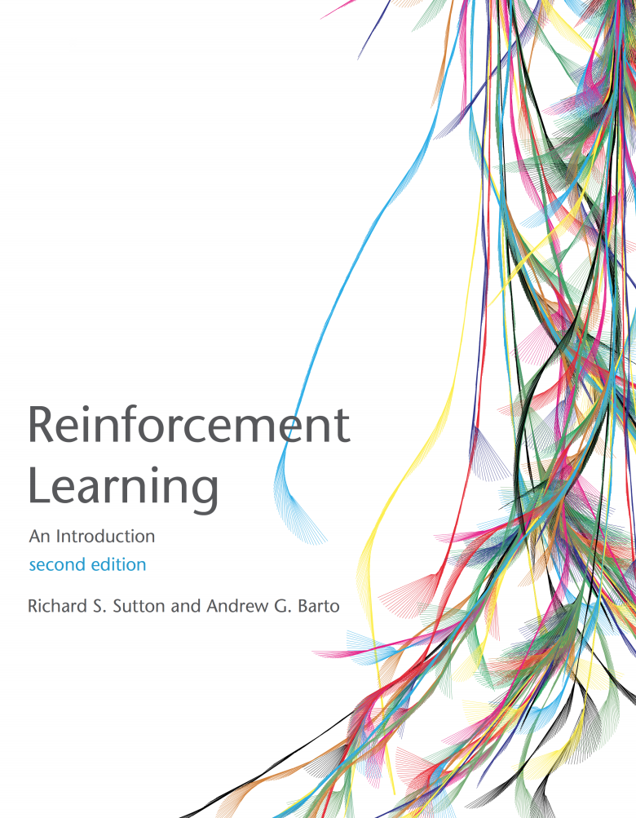
Reinforcement Learning
Read AIMA 21
Also read Sutton and Barton Chapter 6.1, 6.2 and 6.5 (see link on course web site)

Slide 47
Reinforcement Learning
Agent
State: s
Reward: r
Actions: a
Environment
Basic idea:
Receive feedback in the form of rewards
Agent’s utility is defined by the reward function
Must (learn to) act so as to maximize expected rewards
All learning is based on observed samples of outcomes!
Notes:
Basic idea: you have an agent who is acting as always. The agent has actions available to it, and chooses and action.
The environment then does what it always does. It resolves the action. It does this with some non-determinism like before. What the agent gets back from the environment is two things. One is the instantaneous reward. The reward can be a bonus or penalty. This is the thing that we want to learn to maximize. The other thing it gets back is a percept. In the simplest formulation this will be the state that it ends up in, later on we’ll see how to relax this.
In this setting, we won’t know what actions will produce what rewards before we try them. Therefore, we have to learn based on experience. This can be characterized as learning from samples.

Slide 48
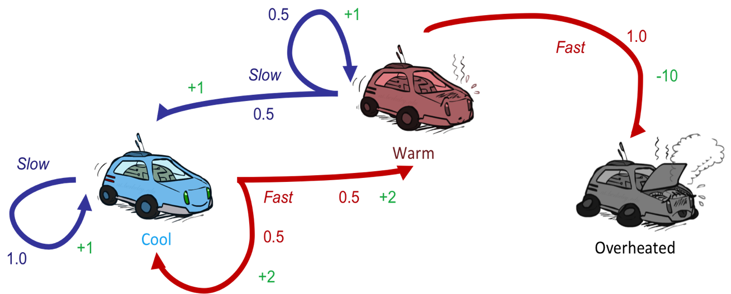
Reinforcement Learning
Still assume a Markov decision process (MDP):
A set of states s ∈ S
A set of actions (per state) A
A model T(s,a,s’)
A reward function R(s,a,s’)
Still looking for a policy π(s)
New twist: don’t know T or R
I.e. we don’t know which states are good or what the actions do
Must actually try actions and states out to learn
Notes:
How is this done?
In reinforcement learning, we still imagine that there’s a MDP. The goal is still to learn a policy.
The new twist is that we don’t know Tor R.

Slide 49
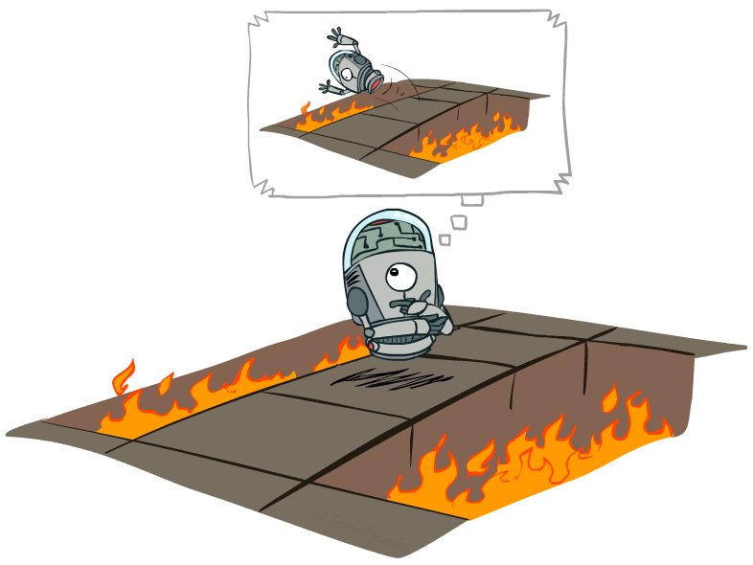
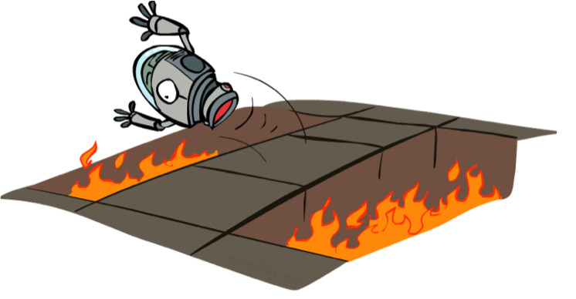
Offline (MDPs) vs. Online (RL)
Offline Solution
Online Learning
Notes:
Offline – in simulation or in your head, you can compute things off and know that it’s bad to jump into the pit.
In online learning, you actually need to take the action.

Slide 50
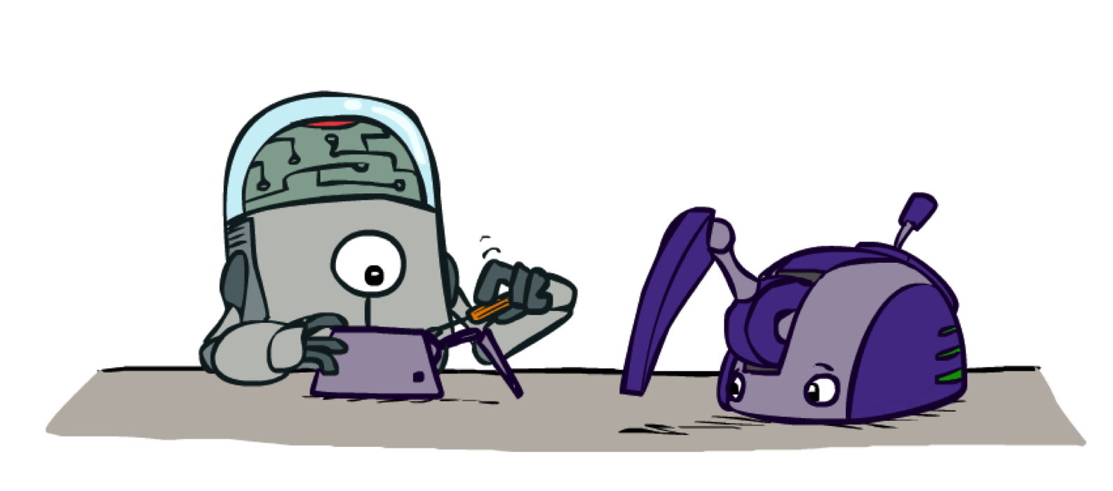
Model-Based Learning
Notes:
In model based learning, we try to figure out the model by learning the transition functions and the rewards. How does that work?

Slide 51

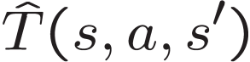

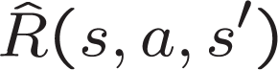
Model-Based Learning
Model-Based Idea:
Learn an approximate model based on experiences
Solve for values as if the learned model were correct
Step 1: Learn empirical MDP model
Count outcomes s’ for each s, a
Normalize to give an estimate of
Discover each when we experience (s, a, s’)
Step 2: Solve the learned MDP
For example, use value iteration, as before
Notes:
We are going to learn an approximate model based on our experiences. Then we’re going to solve for the values as if the learned model were correct.
So how do we do that?
Act for a while. Accumulate counts. Create probabilities. Observe rewards.

Slide 52
Example: Model-Based Learning
Input Policy π
Observed Episodes (Training)
Learned Model
Episode 1
Episode 2
T(s,a,s’).
T(B, east, C) = 1.00
T(C, east, D) = 0.75
T(C, east, A) = 0.25
…
R(s,a,s’).
R(B, east, C) = -1
R(C, east, D) = -1
R(D, exit, x) = +10
…
 | A
B | C | D
 | E
B, east, C, -1
C, east, D, -1
D, exit, x, +10
B, east, C, -1
C, east, D, -1
D, exit, x, +10
Episode 3
Episode 4
E, north, C, -1
C, east, D, -1
D, exit, x, +10
E, north, C, -1
C, east, A, -1
A, exit, x, -10
Assume: γ = 1
Notes:
Someone gives us a policy pi. We say, alright we’re going to do this.
(Here we’re setting the gamma to be one, just to make the example sample).
Ep 1 and 2 are the same.
Ep 3 and 4 are different.
We can then used these observations to compute a model.
The transition from B having selected East results in C 100% of the time.
The transiition from C having picked the action East results in D 75% of the time and A 25% of the time.
Now we have a transition function (probabilities) and the reward function. We now have an MDP. It’s the wrong MDP, but we can solve it.

Slide 53
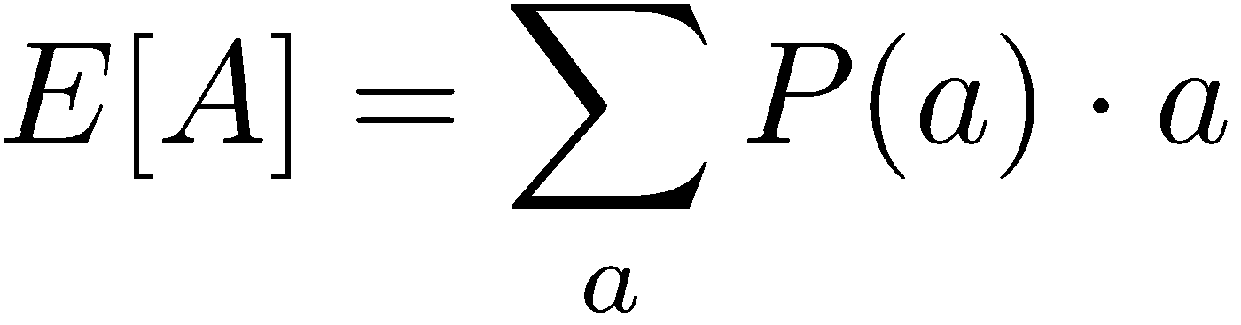
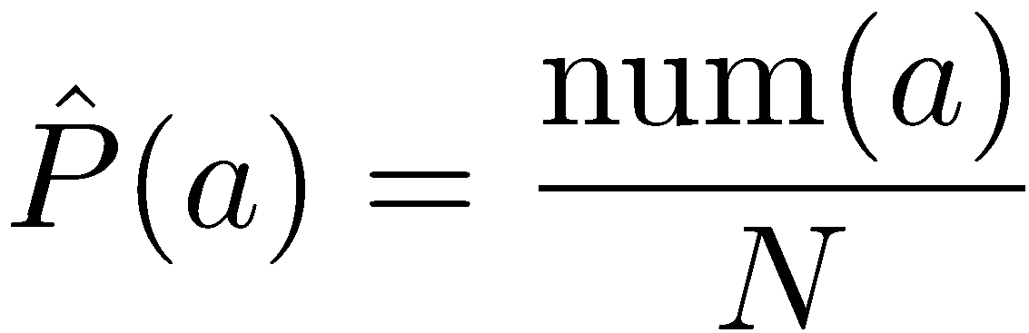
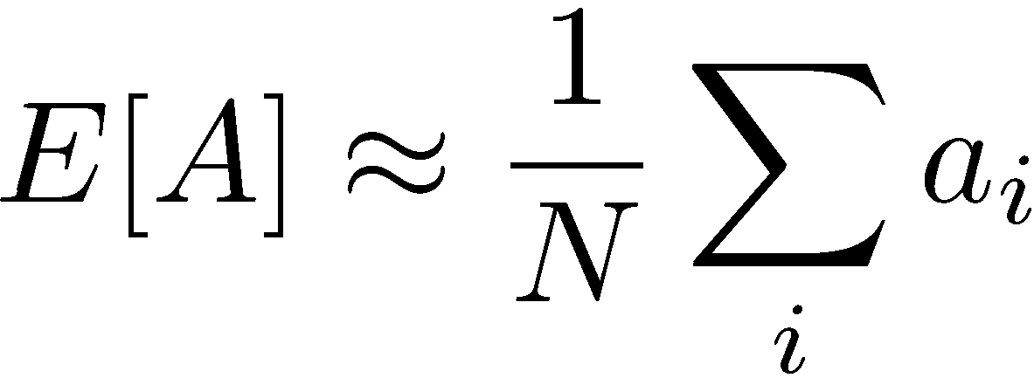
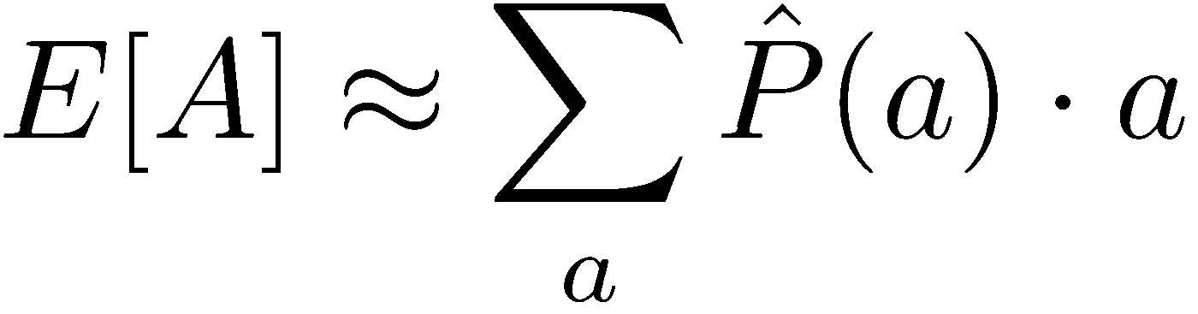
Example: Expected Age
Goal: Compute expected age of CIS 421/521 students
Known P(A)
=0.01 x 42 + …
Without P(A), instead collect samples [a₁, a₂, … a_{N}]
Unknown P(A): “Model Based”
Unknown P(A): “Model Free”
Why does this work? Because eventually you learn the right model.
Why does this work? Because samples appear with the right frequencies.
Notes:
In the model free version we don’t weight by the probability.
But in this case they’re equivalent, since they will appear with the right frequency.
It’s really just a matter of how and when you group things.
In the reinforcement learning there is going ot be a difference because we will take the structure into account. Things are going to depend on the other states around them.
But this gives a good high-level overview of what we mean by model-based v. model free.

Slide 54
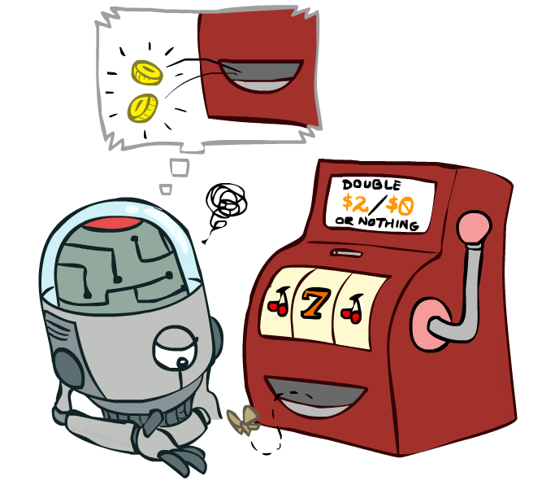
Model-Free Learning
Notes:
now we're going to talk about model free
learning and model free learning we
don't construct a model of the transition function
Instead, we take actions and every time we take an action we compare what we thought was going to happen to what actually did happen.
Whenever something is better or worse than what we expected we adjust our values up and down.
So what we track in a model free approach is the values of interest themselves not the transition functions or the rewards.

Slide 55
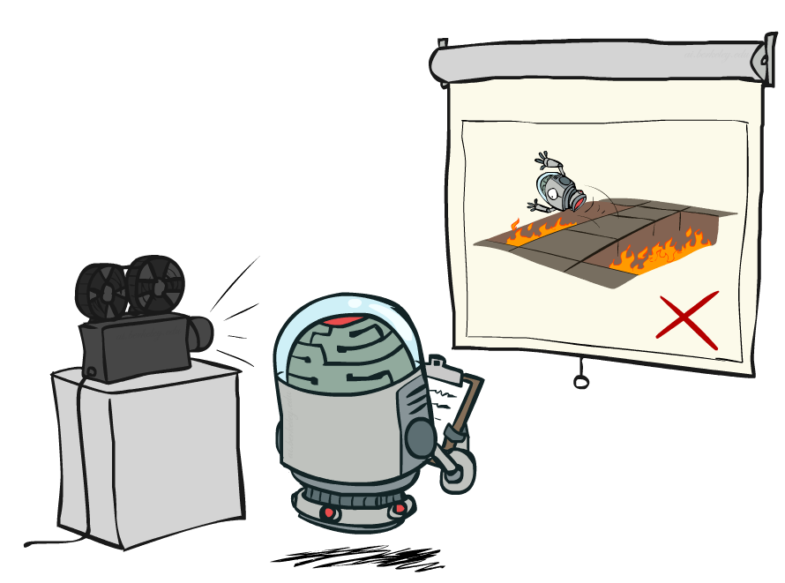
Passive Reinforcement Learning
Notes:
In passive reinfocement learning, someone else chooses the policy. And we observe what happens.
The passive case is this simplified task. We're not going to try to figure out how to act optimally.
We're going try to figure out essentially what policy evaluation did.
The input is a fixed policy. We want to evaluate it.

Slide 56

Passive Reinforcement Learning
Simplified task: policy evaluation
Input: a fixed policy π(s)
You don’t know the transitions T(s,a,s’)
You don’t know the rewards R(s,a,s’)
Goal: learn the state values
In this case:
Learner is “along for the ride”
No choice about what actions to take
Just execute the policy and learn from experience
This is NOT offline planning! You actually take actions in the world.

Slide 57
Direct Evaluation
Goal: Compute values for each state under π
Idea: Average together observed sample values
Act according to π
Every time you visit a state, write down what the sum of discounted rewards turned out to be
Average those samples
This is called direct evaluation

Slide 58
Example: Direct Evaluation
Input Policy π
Observed Episodes (Training)
Output Values
Episode 1
Episode 2
 | A
B | C | D
 | E
 | A
B | C | D
 | E
B, east, C, -1
C, east, D, -1
D, exit, x, +10
B, east, C, -1
C, east, D, -1
D, exit, x, +10
-10
+8
+4
+10
Episode 3
Episode 4
-2
E, north, C, -1
C, east, D, -1
D, exit, x, +10
E, north, C, -1
C, east, A, -1
A, exit, x, -10
Assume: γ = 1
Notes:
We’re given an input policy
We just want to evaluate it.
What utility did I receive from B? Not -1. That was the intentions reward. I want to compute the utility, which is from B until the end. So +8.
Write down what happened.
Why 4 for C? 9 + 9 + 9 - 11 = 16/4 = 4

Slide 59
Problems with Direct Evaluation
What’s good about direct evaluation?
It’s easy to understand
It doesn’t require any knowledge of T, R
It eventually computes the correct average values, using just sample transitions
What bad about it?
It wastes information about state connections
Each state must be learned separately
So, it takes a long time to learn
Output Values
 | A
B | C | D
 | E
-10
+8
+4
+10
-2
If B and E both go to C under this policy, how can their values be different?

Slide 60
Why Not Use Policy Evaluation?
s
Simplified Bellman updates calculate V for a fixed policy:
Each round, replace V with a one-step-look-ahead layer over V
This approach fully exploited the connections between the states
Unfortunately, we need T and R to do it!
Key question: how can we do this update to V without knowing T and R?
In other words, how to we take a weighted average without knowing the weights?
π(s)
s, π(s)
s, π(s),s’
s’

Slide 61
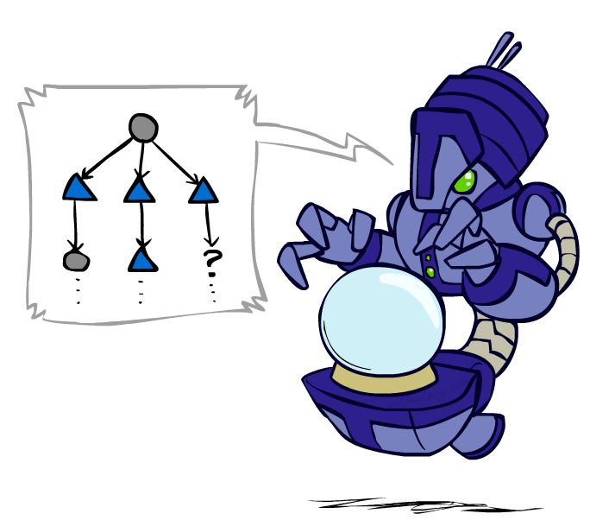
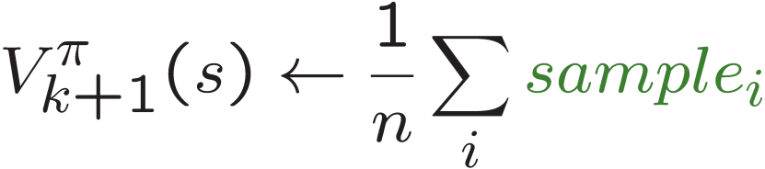
Sample-Based Policy Evaluation?
We want to improve our estimate of V by computing these averages:
Idea: Take samples of outcomes s’ (by doing the action!) and average
s
π(s)
s, π(s)
s, π(s),s’
s₁'
s₂'
s'
s₃'
Almost! But we can’t rewind time to get sample after sample from state s.
Notes:
Can we do sample based policy evaluation?
What’s wrong with this? We don’t get to do lots of actions from state s. We don’t get to rewind and re-do it to get multiple observations.

Slide 62
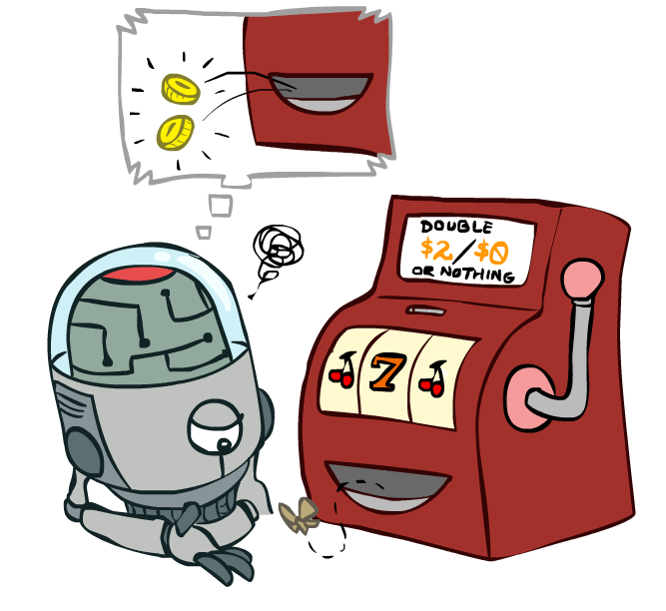
Temporal Difference Learning

Slide 63
Temporal Difference Learning
Big idea: learn from every experience!
Update V(s) each time we experience a transition (s, a, s’, r)
Likely outcomes s’ will contribute updates more often
Temporal difference learning of values
Policy still fixed, still doing evaluation!
Move values toward value of whatever successor occurs: running average
s
π(s)
s, π(s)
s’
Sample of V(s):
Update to V(s):
Same update:
Notes:
The reason this is called temporal difference learning is because we compare our current estimate of a value with what we actually see
Interprolation

Slide 64

Exponential Moving Average
Exponential moving average
The running interpolation update:
Makes recent samples more important:
Forgets about the past (distant past values were wrong anyway)
Decreasing learning rate (alpha) can give converging averages

Slide 65
Example: Temporal Difference Learning
States
Observed Transitions
B, east, C, -2
C, east, D, -2
 | A
B | C | D
 | E
 | 0
0 | 0 | 8
 | 0
 | 0
-1 | 0 | 8
 | 0
 | 0
-1 | 3 | 8
 | 0
Assume: γ = 1, α = 1/2

Slide 66


Problems with TD Value Learning
TD value leaning is a model-free way to do policy evaluation, mimicking Bellman updates with running sample averages
However, if we want to turn values into a (new) policy, we’re sunk:
Idea: learn Q-values, not values
Makes action selection model-free too!
s
a
s, a
s,a,s’
s’

Slide 67


Active Reinforcement Learning

Slide 68

Active Reinforcement Learning
Full reinforcement learning: optimal policies (like value iteration)
You don’t know the transitions T(s,a,s’)
You don’t know the rewards R(s,a,s’)
You choose the actions now
Goal: learn the optimal policy / values
In this case:
Learner makes choices!
Fundamental tradeoff: exploration vs. exploitation
This is NOT offline planning! You actually take actions in the world and find out what happens…

Slide 69
Detour: Q-Value Iteration
Value iteration: find successive (depth-limited) values
Start with V₀(s) = 0, which we know is right
Given V_{k}, calculate the depth k+1 values for all states:
But Q-values are more useful, so compute them instead
Start with Q₀(s,a) = 0, which we know is right
Given Q_{k}, calculate the depth k+1 q-values for all q-states:

Slide 70


Q-Learning
Q-Learning: sample-based Q-value iteration
Learn Q(s,a) values as you go
Receive a sample (s,a,s’,r)
Consider your old estimate:
Consider your new sample estimate:
Incorporate the new estimate into a running average:

Slide 71

Video of Demo Q-Learning -- Gridworld

Slide 72

Q-Learning Properties
Amazing result: Q-learning converges to optimal policy -- even if you’re acting suboptimally!
This is called off-policy learning
Caveats:
You have to explore enough
You have to eventually make the learning rate
small enough
… but not decrease it too quickly
Basically, in the limit, it doesn’t matter how you select actions (!)

